Slide 1
JetHexa with Haar Cascade Classifiers

Slide 2
Haar Cascade
On Tuesday, we learned about Haar Cascade Classifiers to do face detection
So we will not reiterate how Haar Cascades work here
If needed, refer back to Tuesday’s slides, Face_Detection_HAAR
Today, we will take the Haar Cascade Classifiers that you developed and implement that on the JetHexa

Slide 3
Haar Cascade with JetHexa
The Haar Cascade Classifier was trained to detect faces with an input from a web camera
JetHexa has a front facing camera already on the device that we can use for the input
From the previous demonstration, you also learned how to define actions on the JetHexa
Now we can pair the two together
When the Haar Cascade Classifier detects a face from the camera input, we can have the JetHexa perform an action

Slide 4
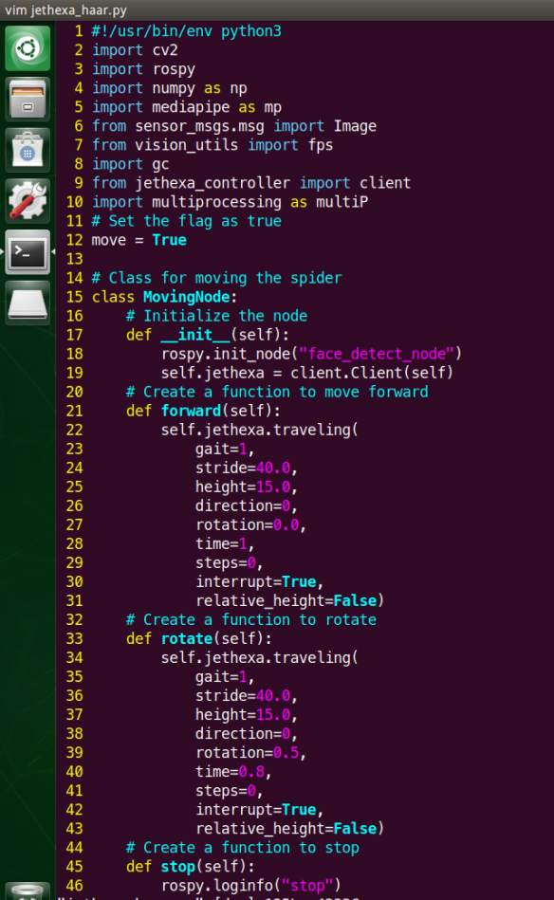
Haar Cascade Code
To run the Haar Cascade Classifier on the JetHexa, we will utilize OpenCV2, which is a Python library to process images and video
The “class MovingNode” is the same moving class we defined in the last demonstration
Which will have the JetHexa move forward and then rotate

Slide 5
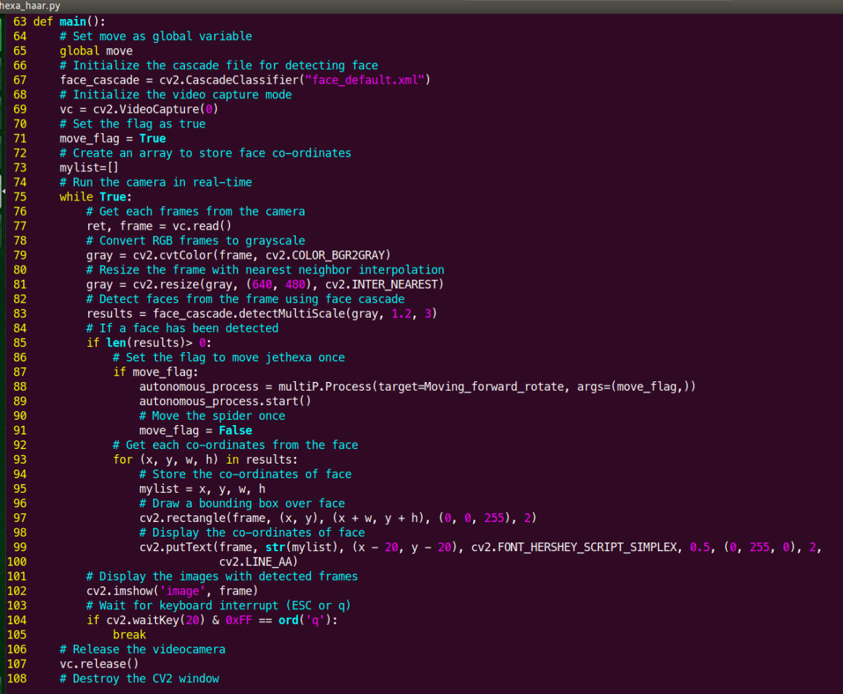
Haar Cascade Code
The actions have also been setup to only run one time after the first detection of a face
If you wish to change this and have it run multiple time, ask your TA’s for help editing the file and change line 91, “move = False” to “move = True”

Slide 6
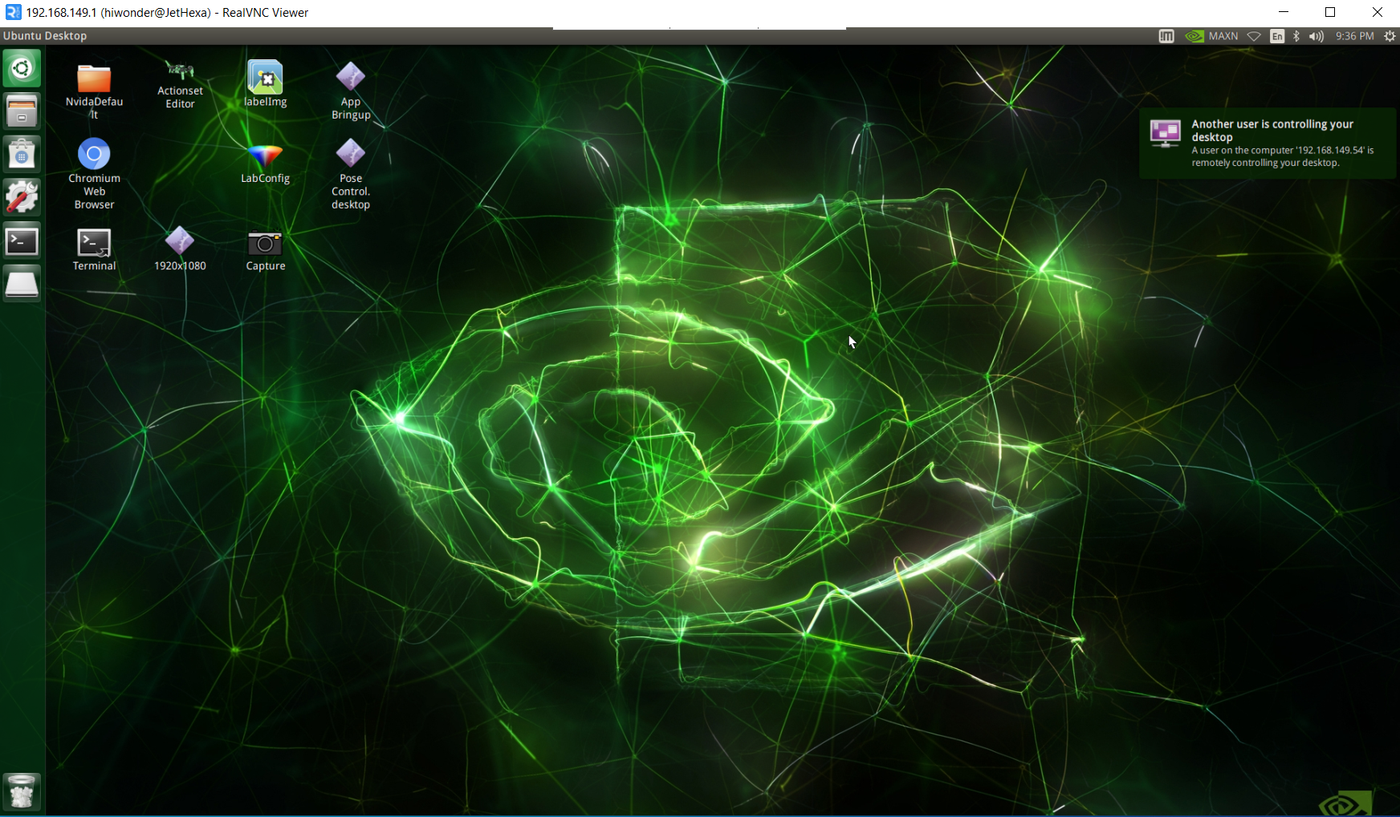
Connect to the JetHexa
From the methods described in the Intro to JetHexa, connect to the JetHexa using UltraVNC

Slide 7
Terminal
Open the terminal
Double click on the terminal icon

Slide 8

Run the Code
Type the following command in the terminal
“python3 jethexa_haar.py”

Slide 9
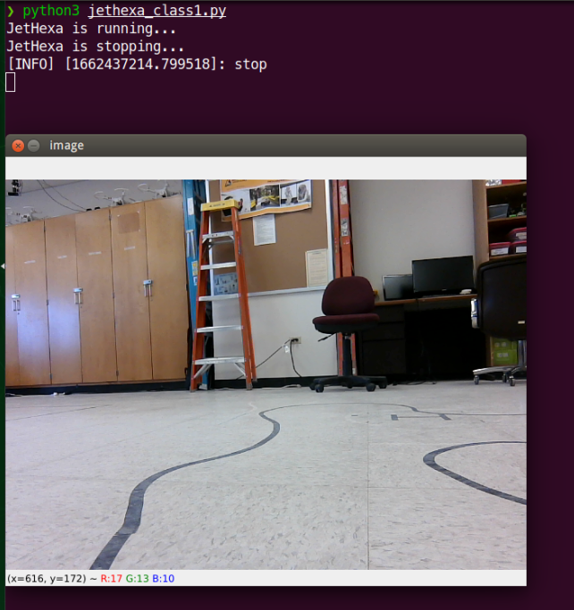
Run the Code
After a few seconds of initialization, a camera window should appear and look similar to below

Slide 10
Play with the code
Look at the front camera and see if the Haar Cascade Classifier detects your face
Does the program only detect your face or does it detect other things as well?
Does the robot move after the initial face detection?

Slide 11
Up Next
JetHexa with MediaPipe

